Slide 1
Does TDM Really Work?
Measuring the effect on VMT

Slide 2
San Francisco’s TDM Ordinance
VMT analysis in CEQA
Existing research
Background
Transtheoretical model
Pre-contemplation
Contemplation
Preparation
Action
Maintenance
Relapse
Bike mode share
Commute mode share

Slide 3
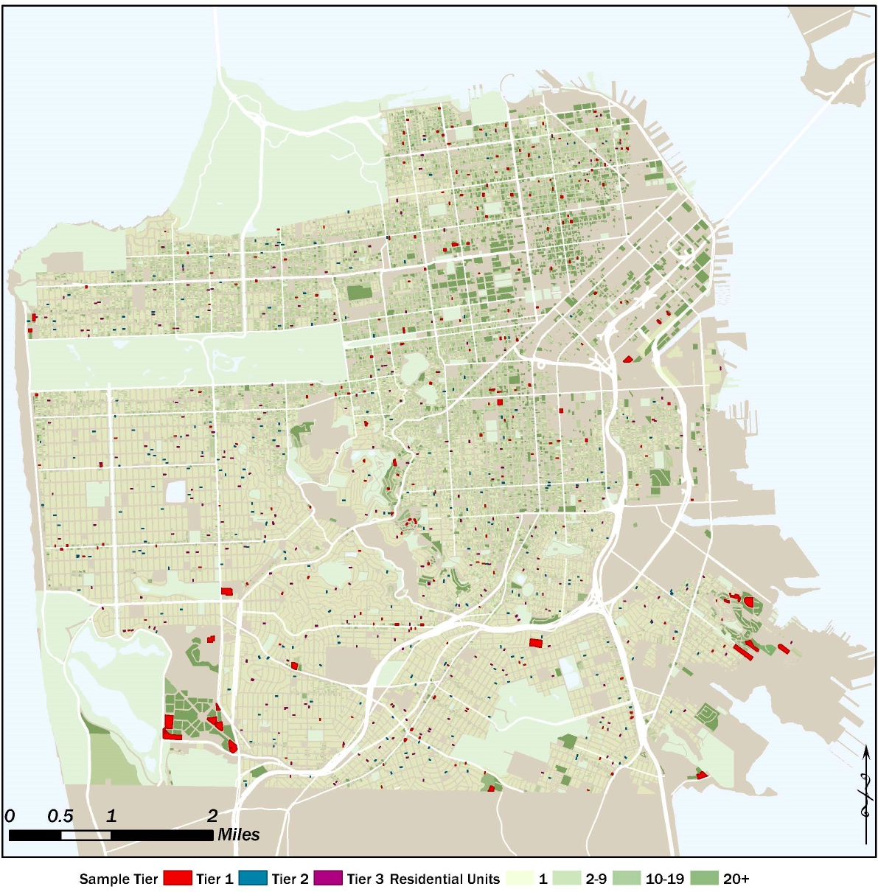
Methodology
Identify strategies
Select sample buildings
Collect travel data
Collect TDM data
Analyze!

Slide 4
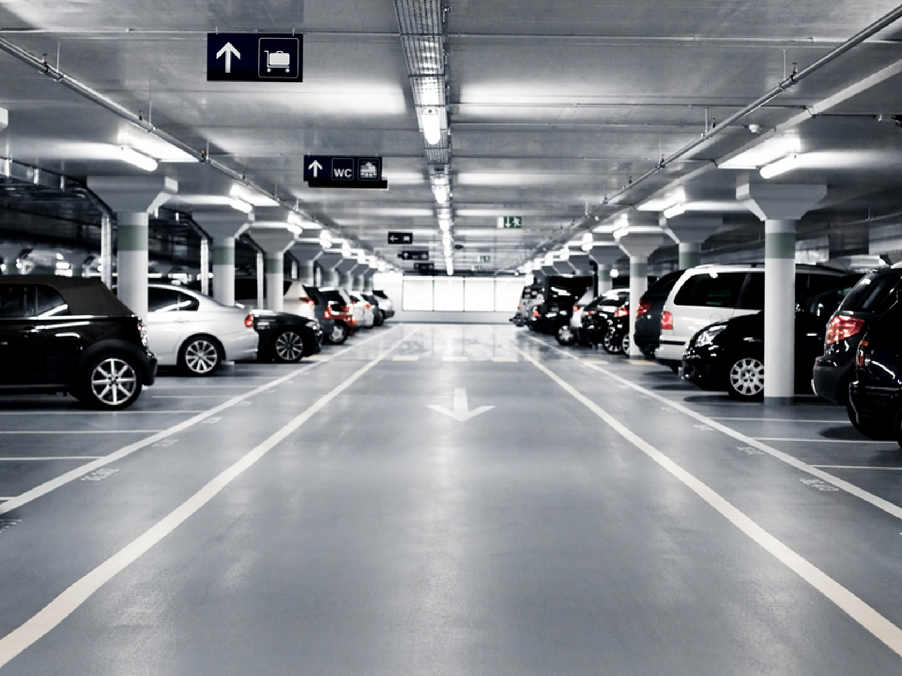
Methodology
TDM Strategies:
Parking supply
Parking unbundling
Sampling:
Buildings of different sizes, ages, locations
With and with out parking strategies

Slide 5
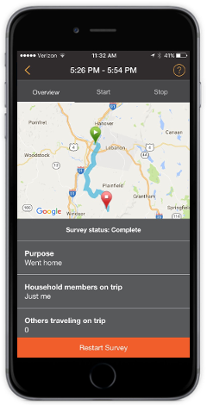
Methodology
Collect travel data:
Recruit survey participants from buildings
Participants complete app-based 7-day travel diary

Slide 6
Methodology
Collect TDM data:
Through the survey
At selected buildings

Slide 7
Preliminary Analysis Who Participated? Census and Survey Distributions by Income

Slide 8
Preliminary Analysis Who Participated? Census and Survey Distributions by Age

Slide 9
Preliminary Analysis Who has access to TDM Subsidies? And who uses them?

Slide 10
Preliminary Analysis Who has access to TDM Subsidies? And who uses them?

Slide 11
Preliminary Analysis Who has access to TDM Subsidies? And who uses them?

Slide 12
Preliminary Analysis Who has access to TDM Subsidies? And who uses them?

Slide 13
Preliminary Analysis Who has access to TDM Amenities? And who uses them?

Slide 14
Preliminary Analysis Who has access to TDM Amenities? And who uses them?

Slide 15
Preliminary Analysis Who has access to TDM Amenities? And who uses them?

Slide 16
Preliminary Analysis Who has access to TDM Amenities? And who uses them?

Slide 17
Next steps / schedule
Develop Sampling Plan: Summer 2019
Data Collection and Processing: Fall 2019
Analysis and VMT Estimation: Spring 2020

Slide 18
Thank you. Any Questions?
drew.cooper@sfcta.org

